Slide 1
WORKSHOP 4

Slide 2
Exercise 1
1 )
*pn = *pm + 2*m - 3*n;
n = *pn = 6 + 2*6 - 3*7= -3
*pm -= *pn;
m = *pm = *pm - *pn = 6 -(-3) = 9
=> Out = m + n = 9 - 3 = 6
2 )
*p1 +=3 => c1 = *p1 = *p1 + 3 = c1 + 3 = A + 3 = D
* p2 -= 5 => c2 = *p2 = *p2 - 5 = F - 5 = A
=> Out = C1 - C2 = *p1 - *p2 = D - A = 3
3 )
X= *p1 += 3 - 2*(*p2) = *p1 + 3 - 2*5.1 = 3.2 + 3 - 2*5.1 = -4
Y= *p2 -= 3*(*p1) = p2 - 3*(p1) = 5.1 - 3*(-4) = 17.1
=> Out = x + y = -4 + 17.1 = 13.1

Slide 3
Exercise 2
m = *p1 = *p1 + 12 - m + (*p2) = 7 + 12 - 8 + 8 = 19
n = *p2 = m + n - 2*(*p1) = 8 + 19 - 2*19 = -11
=> Out = m + n = 19 - 11 = 8

Slide 4
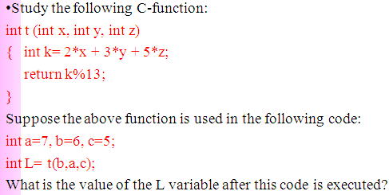
Exercise 3
1 ) L = 2 *6 + 3*7 + 5*5 = 58

Slide 5
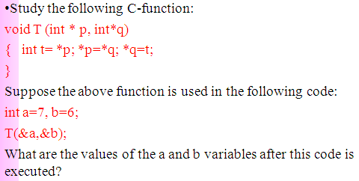
2 )
t = 7 = *p = *q = t => b = 7 => a = 6
=> Out T(6, 7)

Slide 6
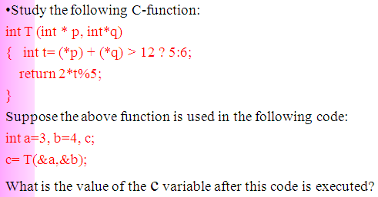
3 )
a = *p = 3
b = *q = 4
(*p) + (*q) = 3 + 4 = 7 < 12 => t = 6 => return = (2*6) % 5 = 2

Slide 7
Part 2 : Program 1

Slide 8
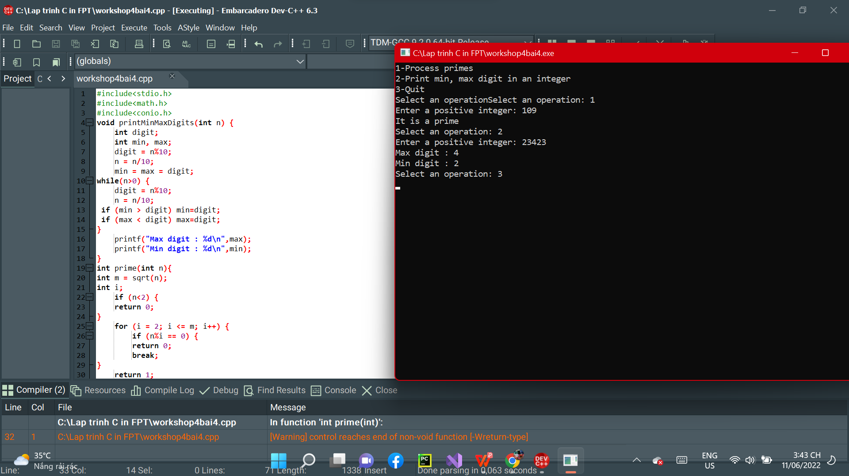

Slide 9
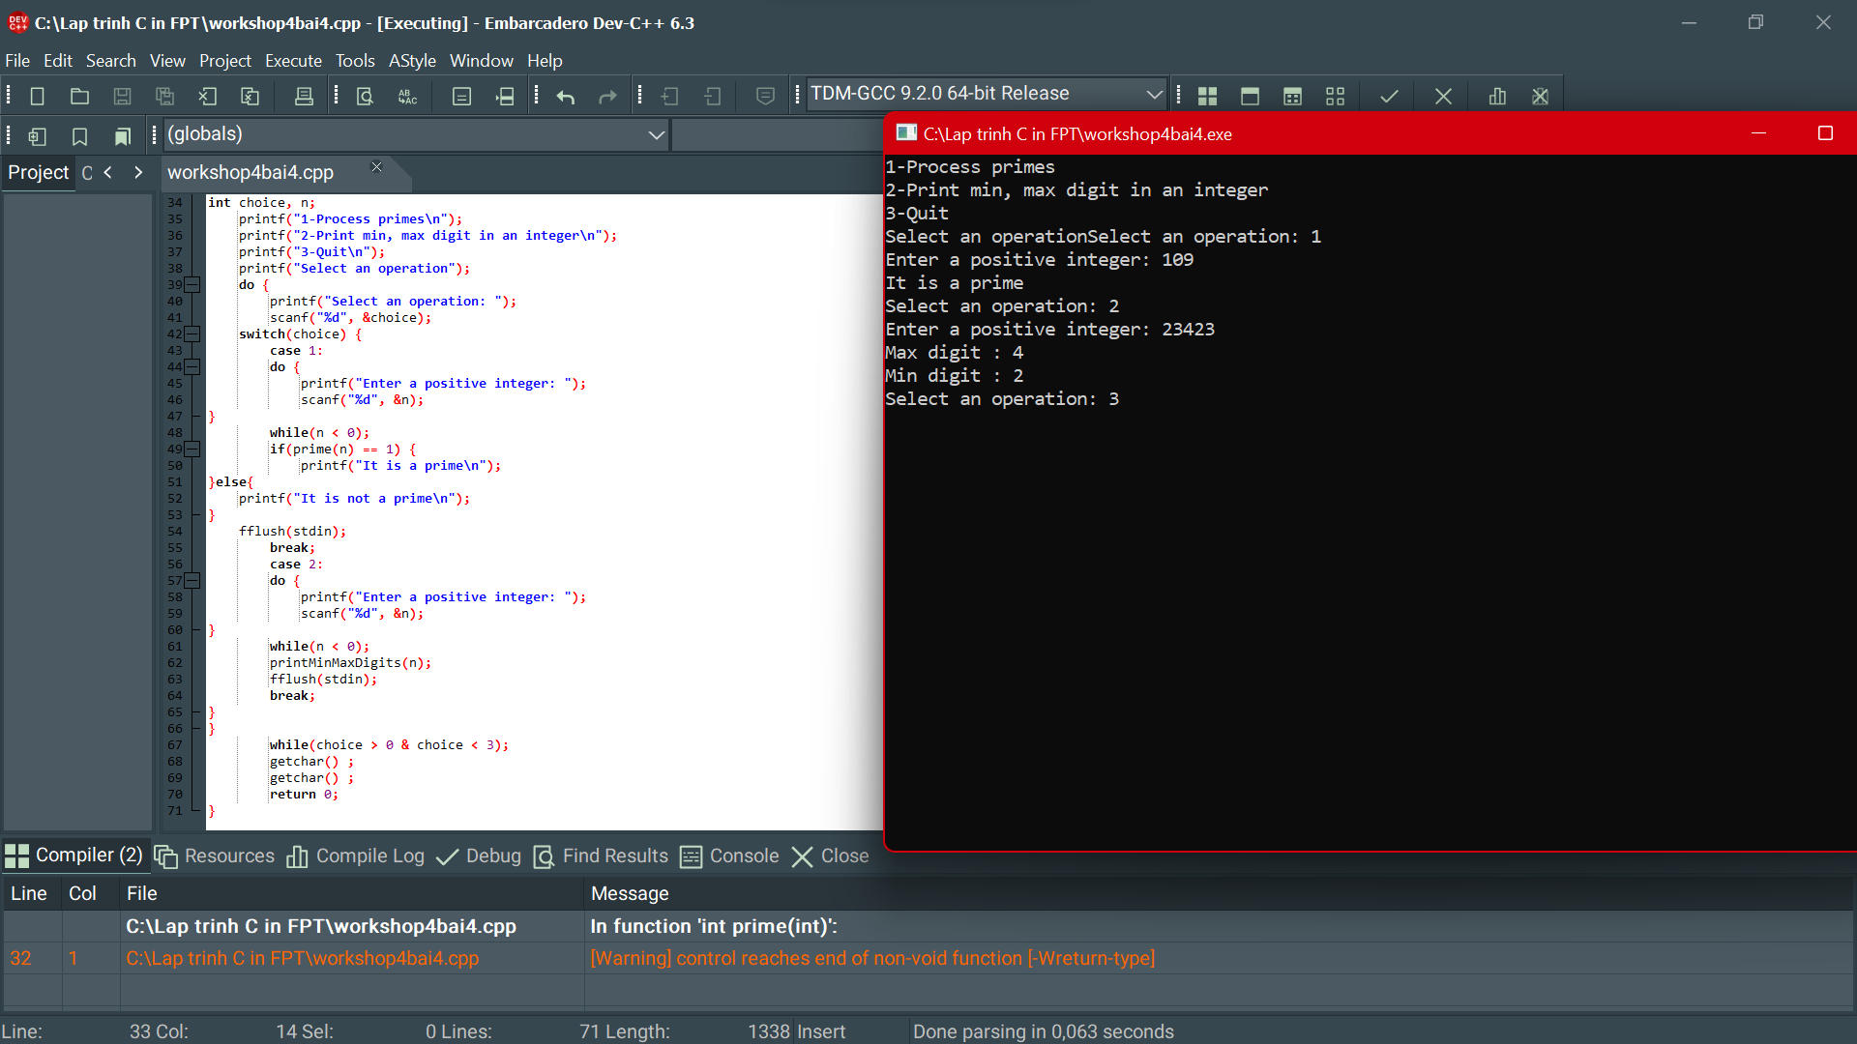

Slide 10
Part 2 : Program 2

Slide 11
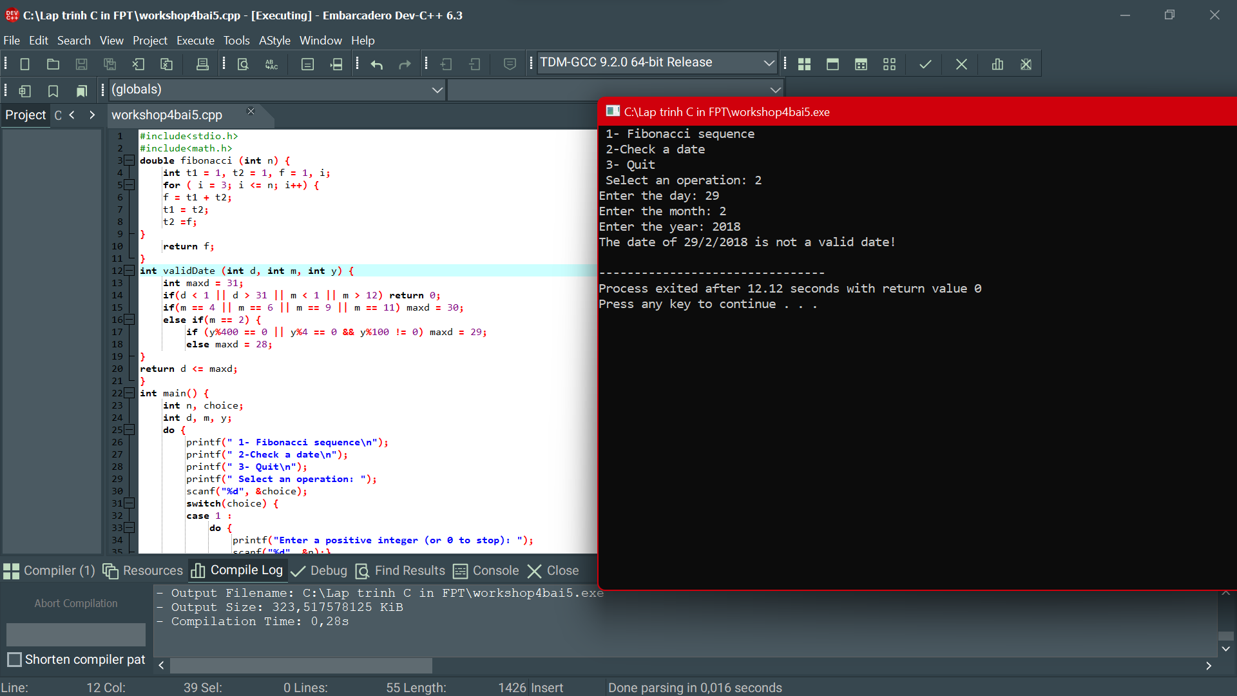

Slide 12
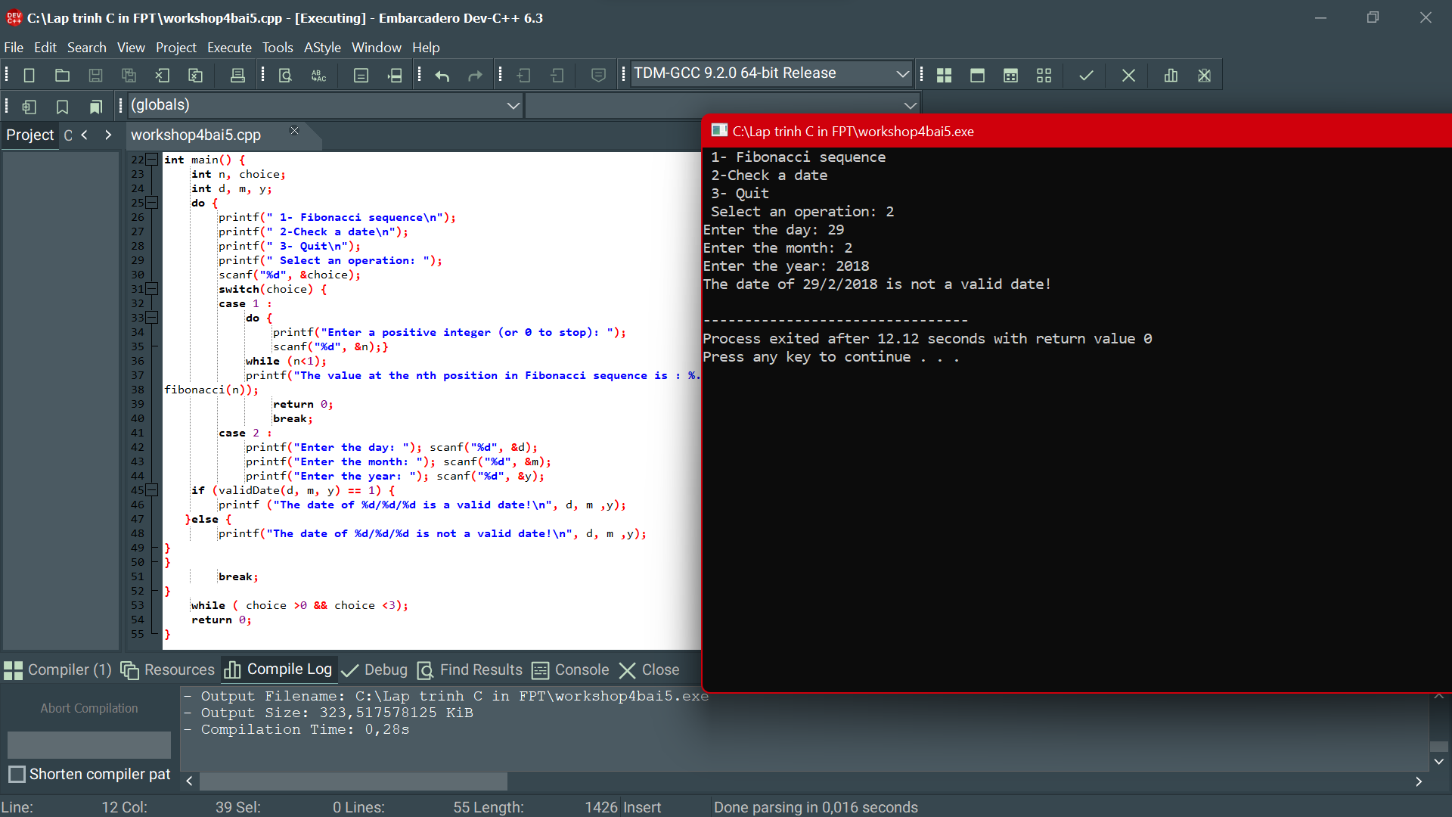

Slide 13
THANKS

